Slide 1
CPEN 400Q
Variational Graphical Quantum Error Correction
Group 8: Lina Bekken Babusiaux Kaushik Kolla Richard Nguyen
Notes:
KK

Slide 2
Table of Contents
Introduction
VGQEC
I.
II.
What’s the problem?
Any solutions?
Implementation
Results
III.
IV.
How is it implemented?
Did it work?
Notes:
KK

Slide 3
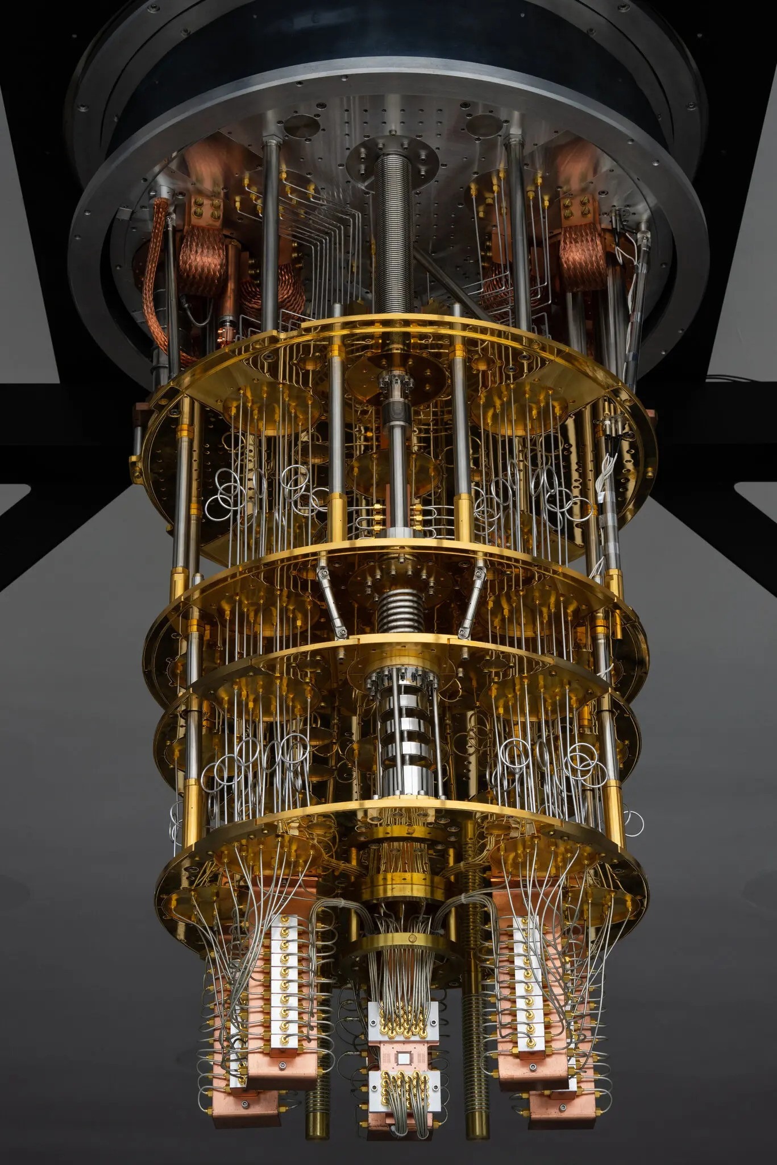
I.
Introduction
Notes:
KK

Slide 4



Introduction
Current Strides in Error Correction
Google’s Willow (Dec 2024)
105 qubits
Demonstrated error rates decrease as code size increases.
Notes:
KK
Error rate for a standard CPU is measured in errors per billion (EPB) or errors per trillion (EPT)
But current state-of-the-art quantum computers have error rates that are typically in the range of 1% to 0.1%.

Slide 5
Introduction
Basic types of Error Correction
Repetition
Stabilizers - [[5,1,3]] code
Simplest error correction strategy
Can only correct only one type of error (X or Z, not both)
Detects errors using majority voting
Requires many physical qubits per logical qubit
Cannot correct both bit and phase-flips simultaneously
Smallest code that detects and corrects all single-qubit errors (X, Y, Z)
1 Logical qubit → 5 physical qubits
High efficiency
Complex
Requires non-local stabilizers
Syndrome decoding is non-trivial compared to repetition
Notes:
KK

Slide 6
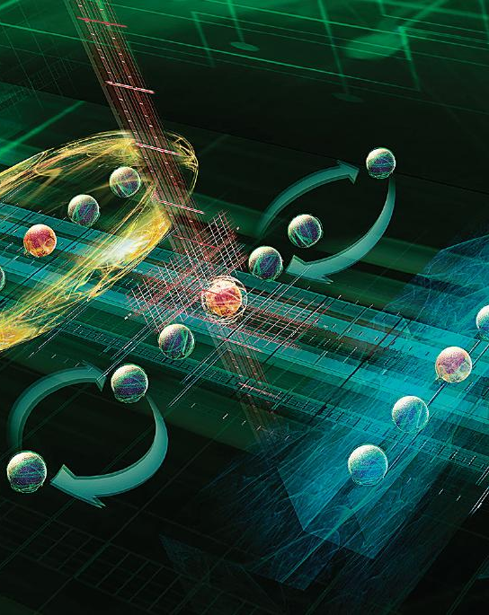
II.
VGQEC
Notes:
richard

Slide 7

VGQEC
Hybrid Quantum-Classical scheme for VGQEC (12 Mar 2025) [1]
[1] https://arxiv.org/abs/2410.02608
Notes:
richard

Slide 8
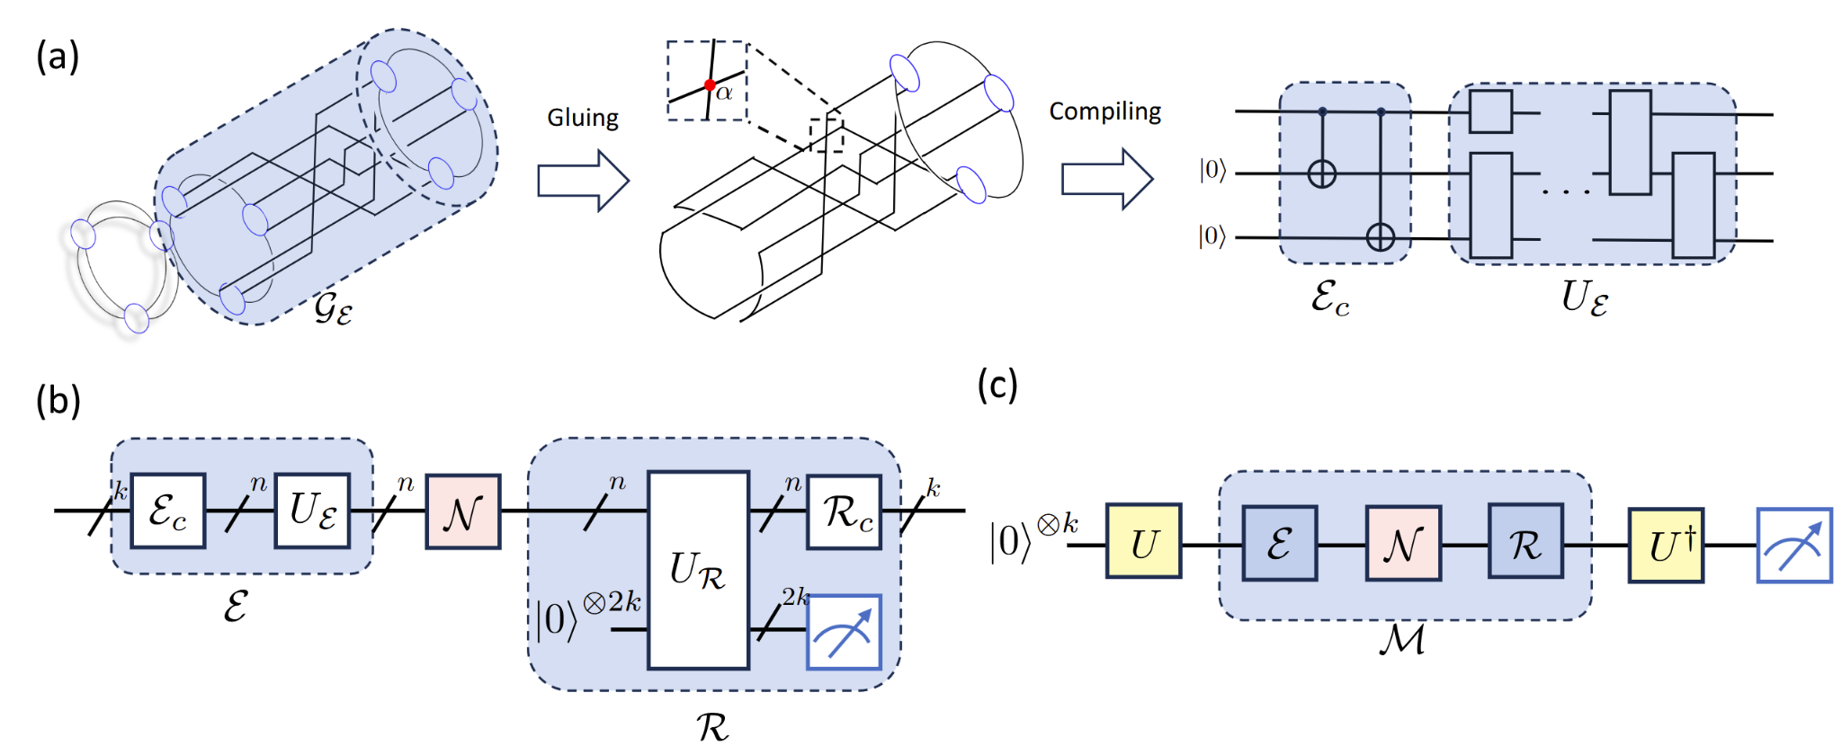
VGQEC
a) Build new code by adding a flexible graph (GE) to existing code’s QEC Quon graph. Creates new encoding circuit with tunable parameters.
Notes:
richard

Slide 9
VGQEC
b) Run noisy circuit using encoding and recovery steps. Recovery circuit uses extra helper (auxiliary) qubits and measurements to correct noise.

Slide 10
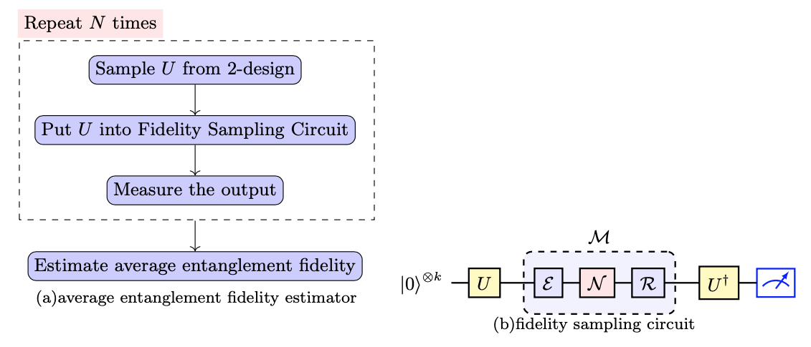
VGQEC
a) Repeatedly run circuit with random quantum state and count output of all zeros.
b) Create random quantum state, send through noise, reverse randomness, and measure.

Slide 11
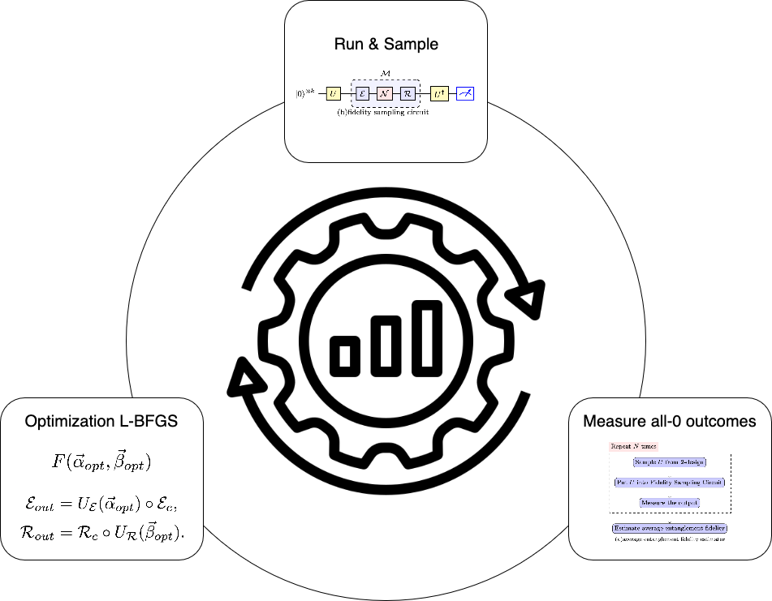
VGQEC

Slide 12
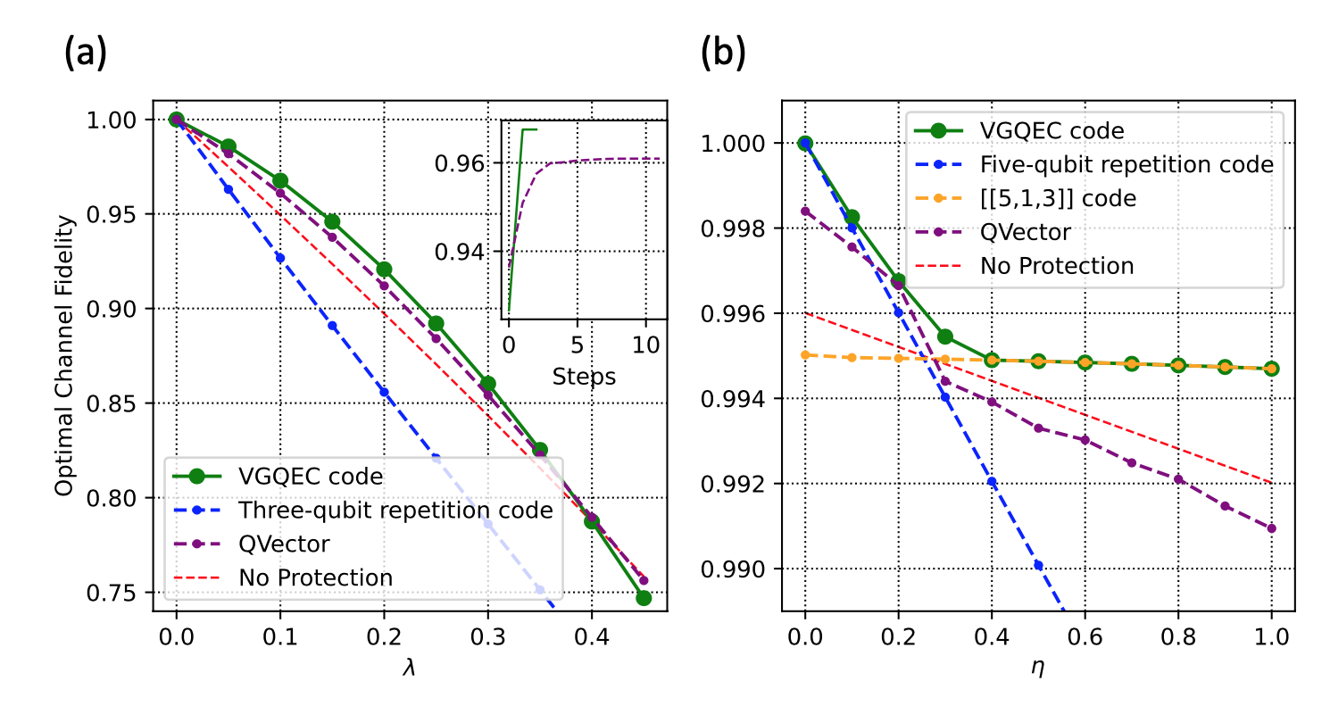
VGQEC
Simulation-based optimization results (theoretical exploration):
a) Three-qubit VGQEC code optimized to handle amplitude damping noise.
b) Five-qubit VGQEC code is tested under changing noise conditions over time.
Notes:
linear interpolation from the dephasing channel to the depolarization channel.

Slide 13
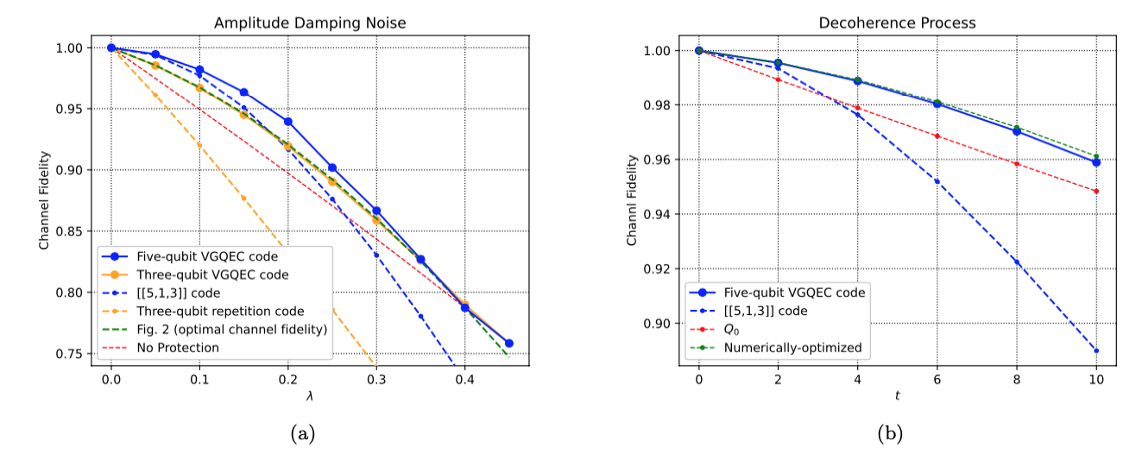
VGQEC
Circuit-level implementation and performance (practical realization):
a) Three-qubit VGQEC code's fidelity compared under amplitude damping noise.
b) Five-qubit VGQEC code evaluated under IBM-LIMA machine data, uneven noise thermal relaxation.

Slide 14
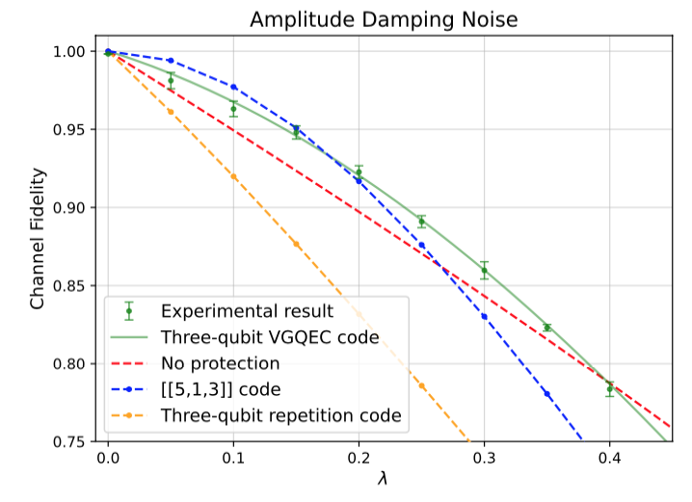
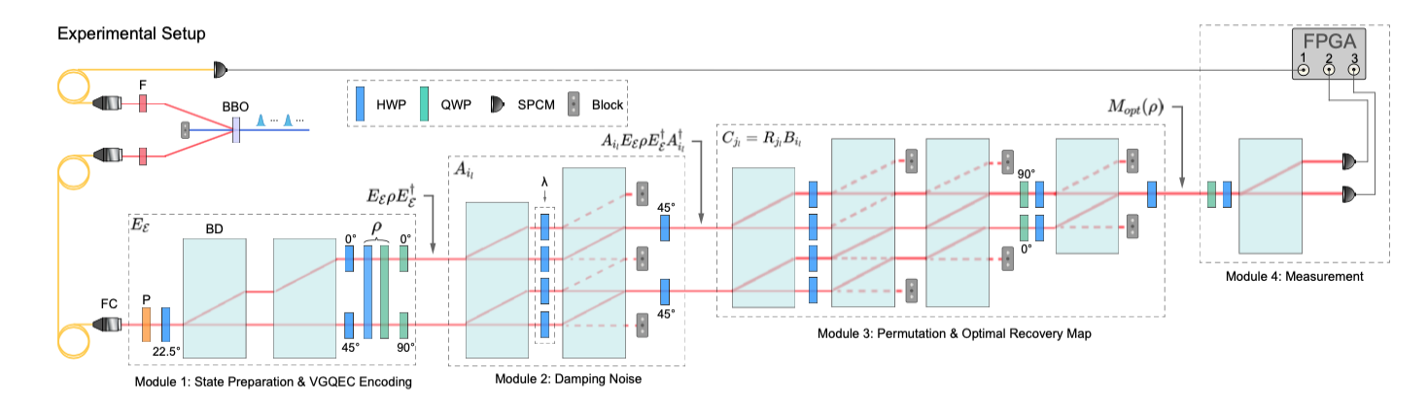
VGQEC
Experimental setup: Uses photons and optical elements to physically implement and test three-qubit VGQEC code.

Slide 15

VGQEC
VGQEC Limitations
1
Parameter Placement Unclear
2
Recovery is Challenging
3
Encoding Not Yet Optimized
Notes:
Graph surgeries lack optimal guidance When designing the code, we modify a kind of "graph structure" with adjustable parts—but there’s no clear rulebook for where or how to place these adjustable pieces, so we have to guess or try different things.
Recovery map construction is challenging To fix errors after the noise hits, we need to design a special correction step—but figuring out the best one can be hard, especially if we don’t fully understand the noise, and training one with a circuit can take a lot of time and computer power.
Encoding map optimization is unexplored Right now, the method focuses on how to correct the logical information, but we haven’t yet explored how to redesign the input step (the encoding) to make the whole process simpler or more efficient—that’s still a new idea to try.

Slide 16
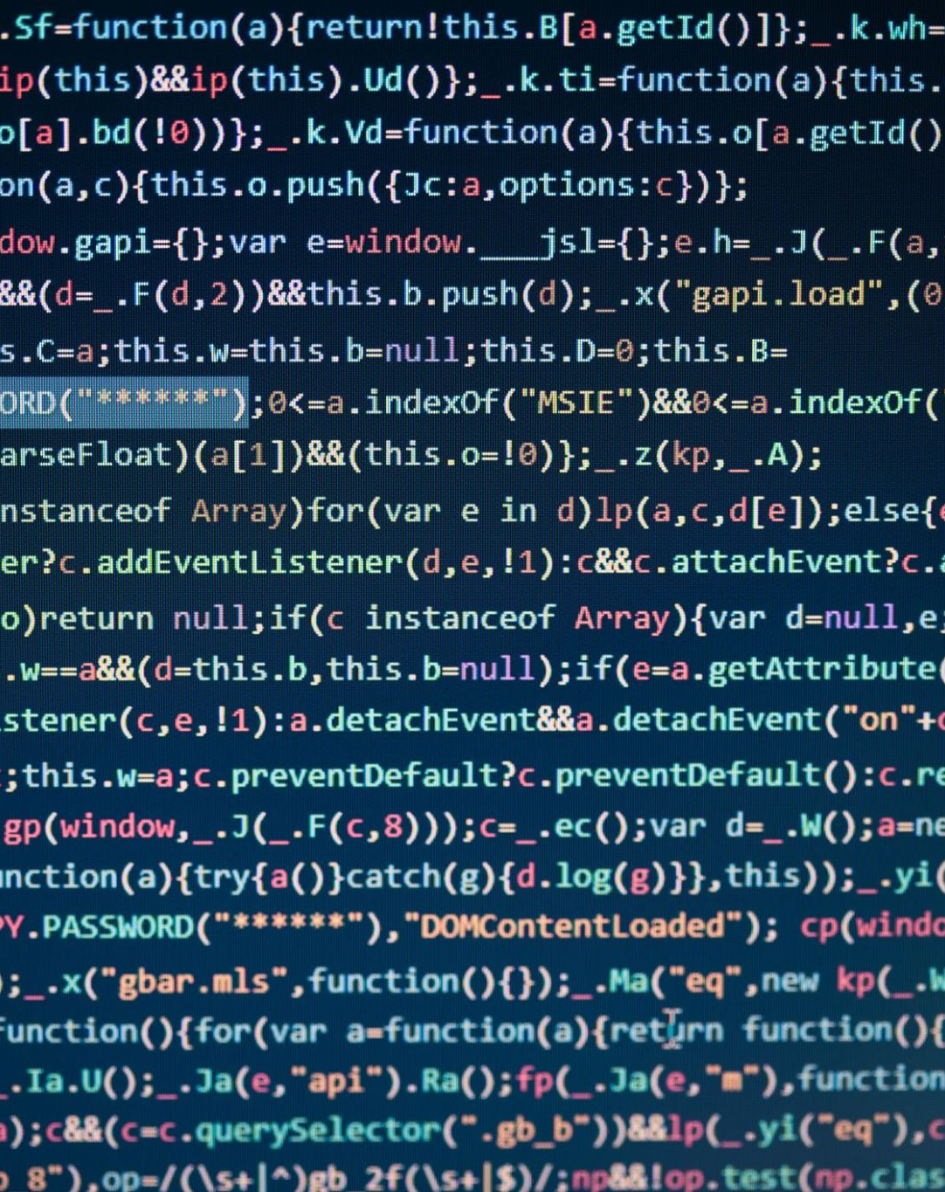
III.
Implementation
Notes:
Lina

Slide 17

Implementation
Scope of Implementation
1
No quon language/graph
2
No SDP for optimal recovery map
3
Less methods for comparison
4
No photonic realization
5
Did not implement optimizer
Notes:
Lina
No quon language
No quon graph for VGQEC
These are just visual representations^^
No SDP for optimal recovery map (optimal channel fidelity). Changes recovery circuit for optimal recovery
Did not graph additional methods for comparison: Q_0, Numerically-optimized,
No actual hardware implementation using PHOTONIC REALIZATION
We did not make a specific optimizer for our implementation. Found one online

Slide 18
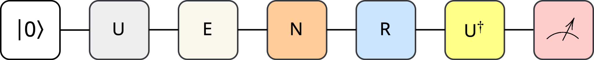
Implementation
Implemented Quantum Circuit
Notes:
lina

Slide 19
Implementation
Unitary
Notes:
Lina
First thing we need to do is set the logical qubit to a given state so we are able to test for multiple different gates and taking the invers of that gate before measuring.

Slide 20
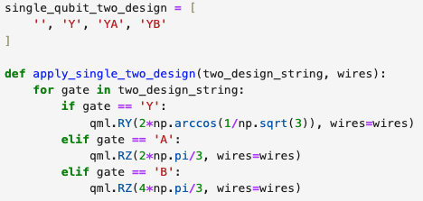
Implementation
Unitary
From paper
Our implementation
Notes:
Lina
In the paper this was done by choosing one of these random gates, which is what we have implemented in a similar way to what we did in the hands on 4 with the cliffords gate.

Slide 21
Implementation
Encoding
Notes:
Encoding - from one logical qubit to n physical qubits

Slide 22
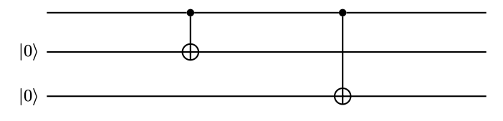
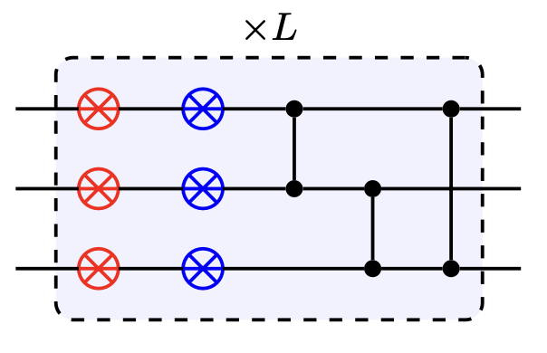
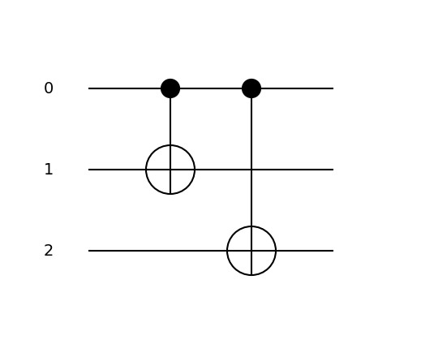
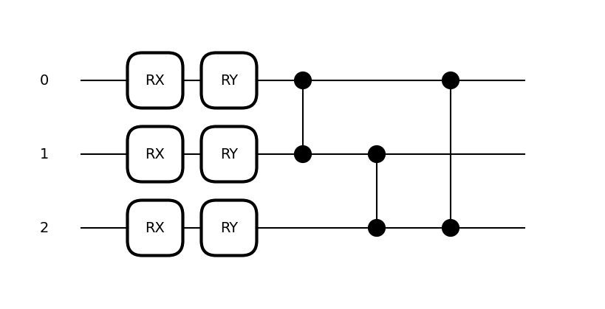
Implementation
Encoding - 3 qubit VGQEC
Original
VQC
From paper
From paper
Our implementation
Our implementation
Notes:
Lina
As talked about earlier, one encoding map and one VQC.
The original encoding they use for 3 qubit is repetition code, so we use that encoding. Variational code taken from the paper. Assumption: L is 2. Paper does not say anything explicitly for 3 qubit VGQEC, but mentions L=2 for another imlpementaion.

Slide 23
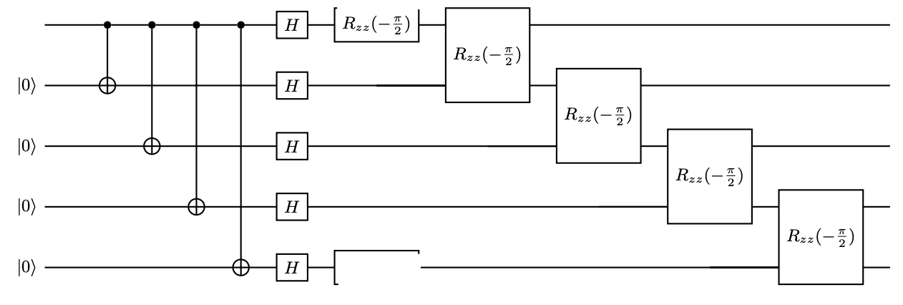
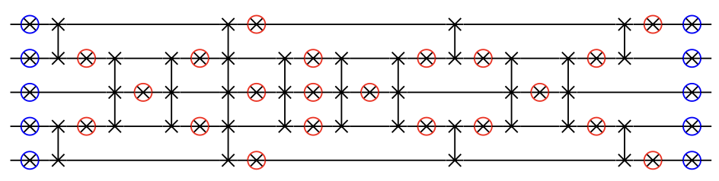
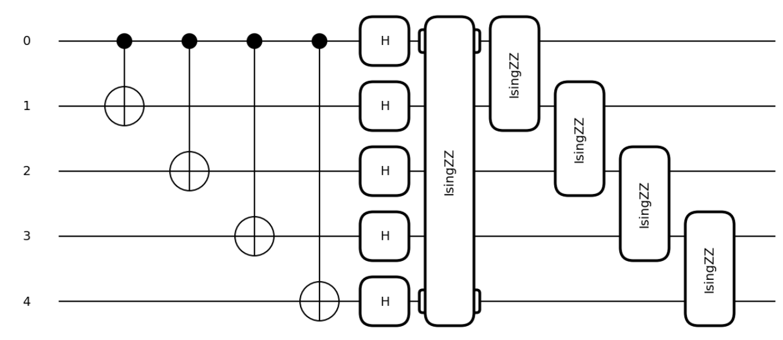
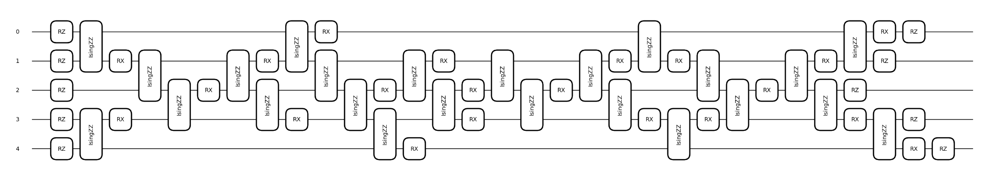
Implementation
Encoding - 5 qubit VGQEC
Original
VQC
From paper
From paper
Our implementation
Our implementation
Notes:
Lina
5 qubit - 513 original encoding where alpha is -pi/2. Variational code taken from the paper

Slide 24
Implementation
Noise
Notes:
KK
We used qml.AmplitudeDamping for values between 0 and 0.5

Slide 25
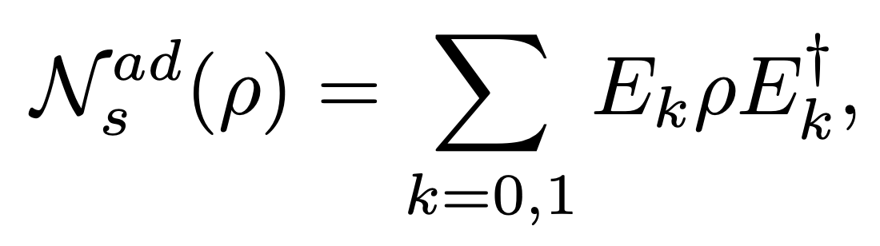
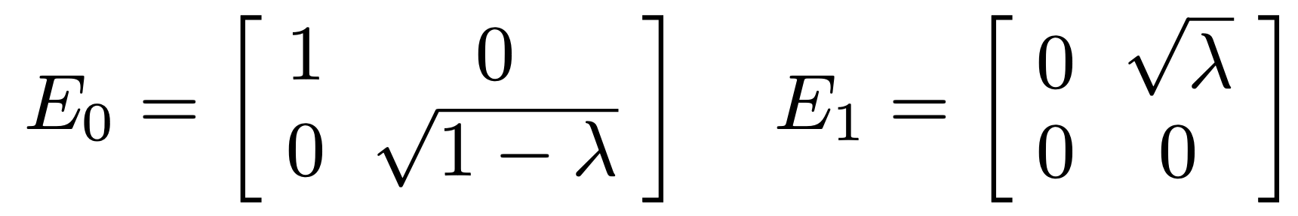
Implementation
Noise - Amplitude Damping
From paper
Our implementation
Notes:
KK

Slide 26
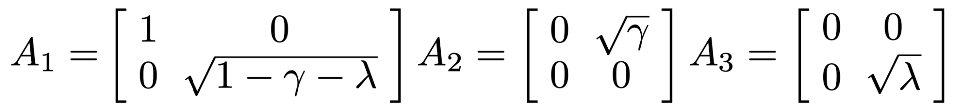
Implementation
Noise - Thermal Relaxation
From paper
Our implementation
Notes:
KK

Slide 27
Implementation
Recovery
Notes:
KK

Slide 28
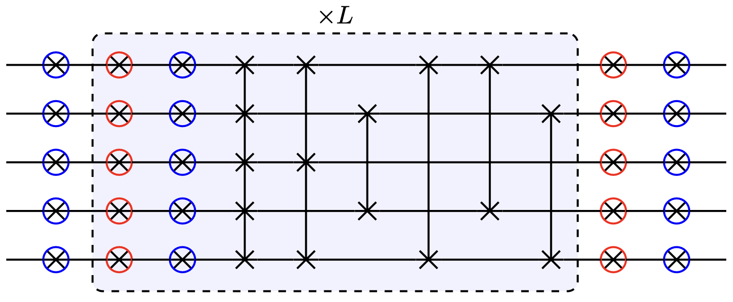
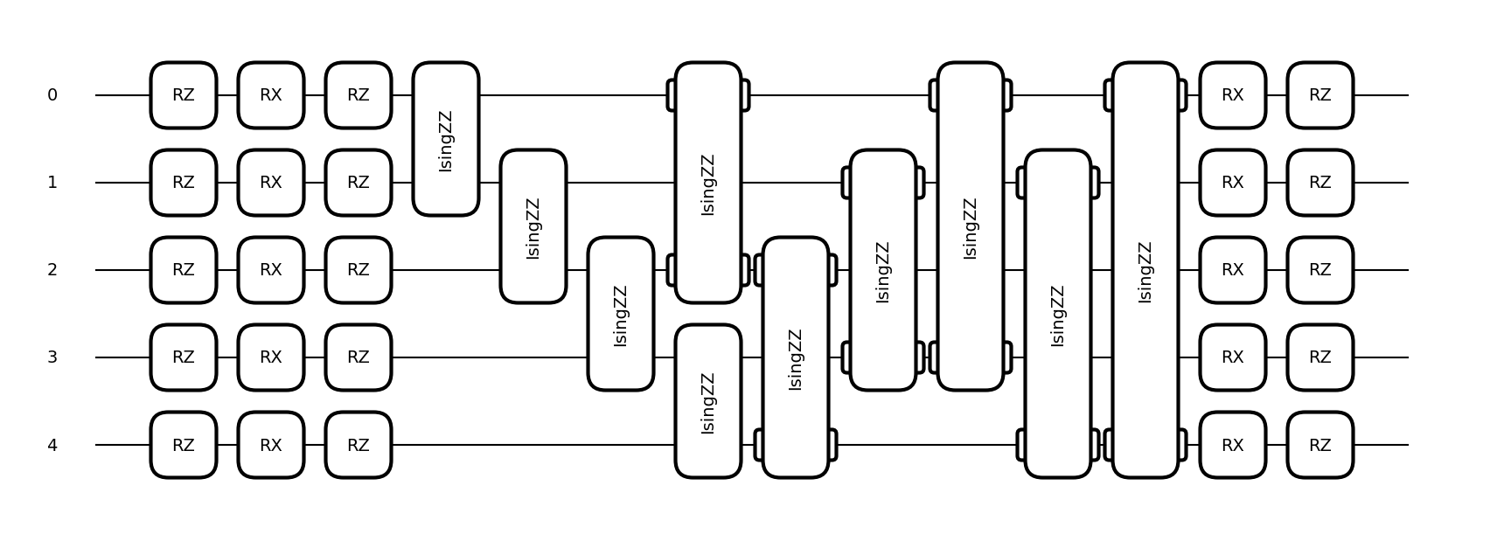
Implementation
Recovery- 3 qubit VGQEC
Original
VQC
From paper
From paper
Original recovery
Our implementation
Our implementation
Not needed (assumption)
Notes:
KK
BLUE, RED , BLACK, RX,RZ, RZZ
Since this is a small circuit, the variational quantum circuit should be able to correct the error by it self when optimizing (assumption from appendix, nothing is specifically said, we tried both and got better result without). This is why the recovery map is not used for the 3-qubit VGQEC and only the recovery VQC is used. Variational code taken from the paper. Wires in the VQC is n (physical qubits) + 2k (logical quibts) Assumption: the two extra wires are not used for anything else then entanglement.

Slide 29
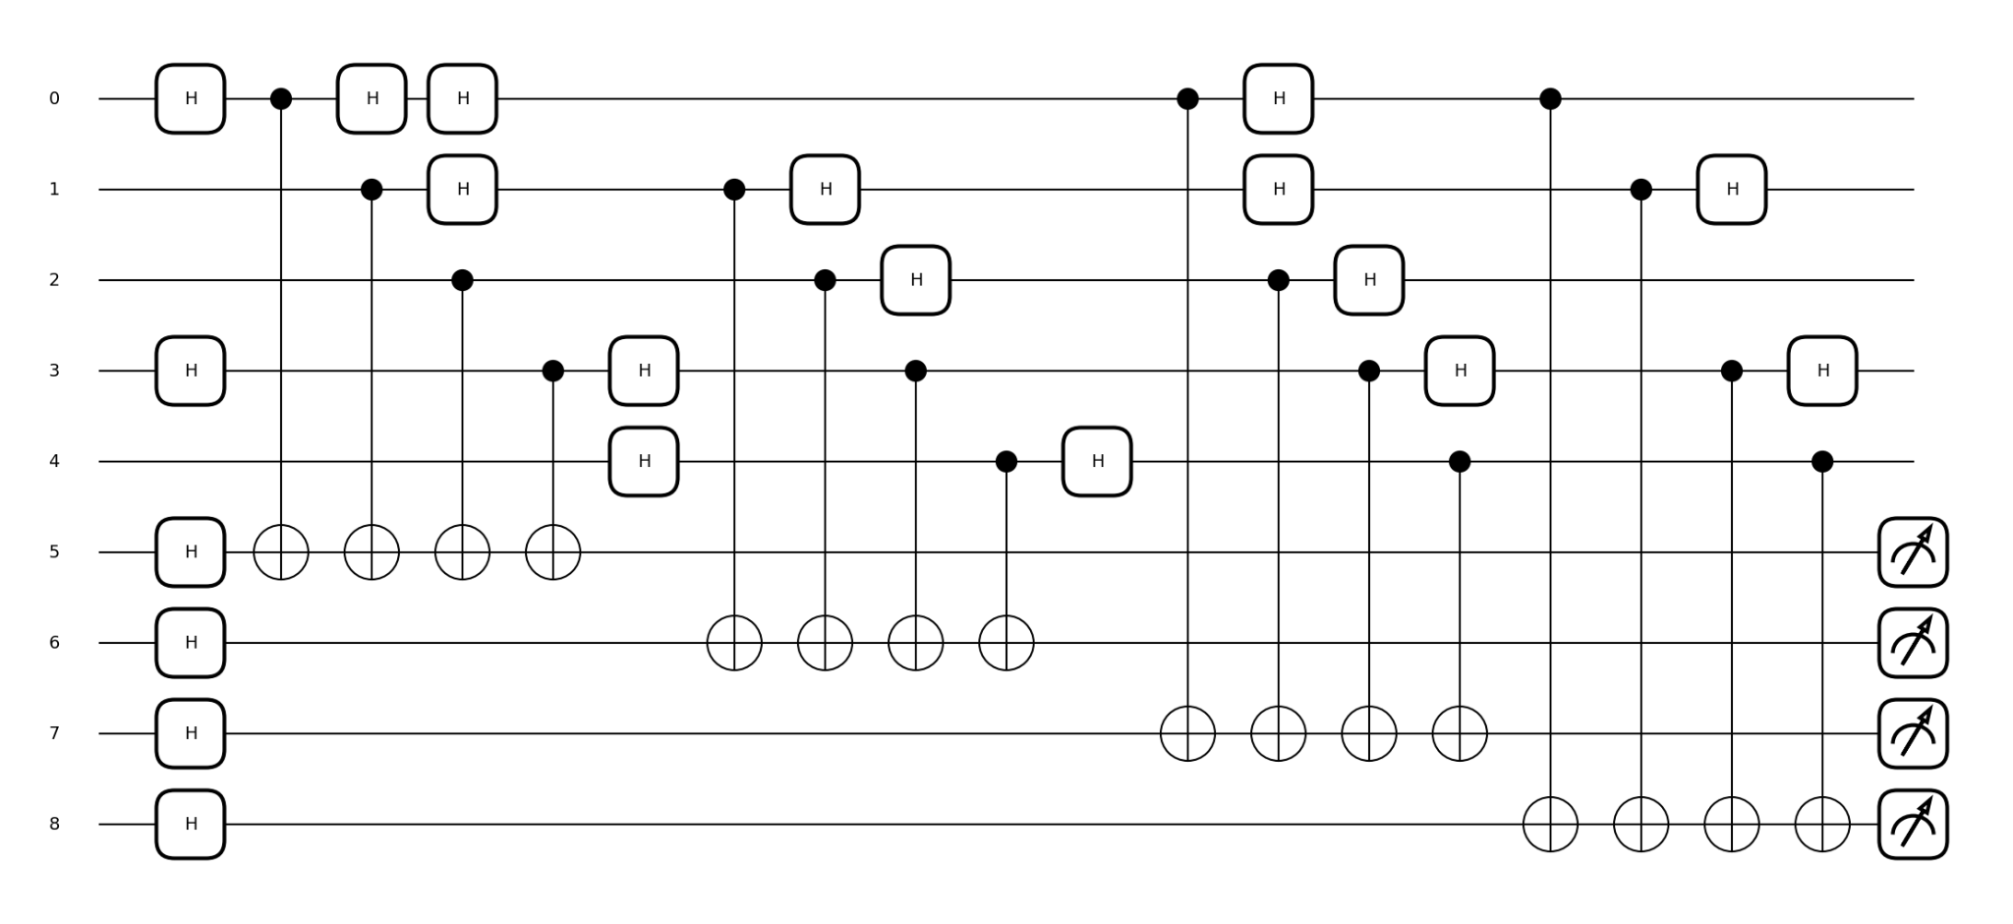
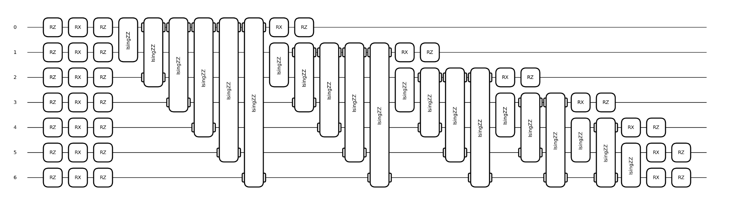
Implementation
Recovery- 5 qubit VGQEC
Original
VQC
From paper
From paper
Original recovery
Our implementation
Our implementation
Notes:
KK
Same decoding as for 513 code with alpha equal to . Variational code taken from the paper, with two wires added as U_r is supposed to have n + 2*k wires. L=3 is used in paper. Assumption: 513 is not given, so our implementation is an assumption.

Slide 30
Implementation
Fidelity
Notes:
richard

Slide 31
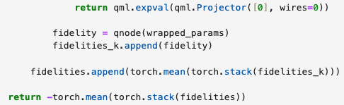
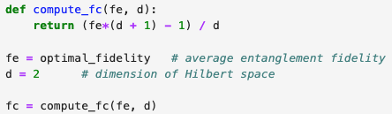
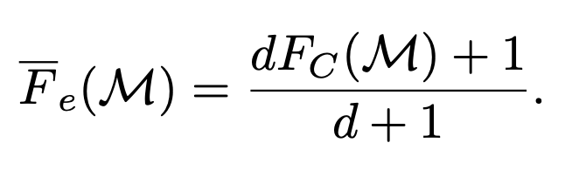
Implementation
Fidelity
From paper
Our implementation
Notes:
Richard
PyTorch’s torch.mean() expects a tensor, not a plain list.
qnode(wrapped_params)
This runs the full quantum circuit using wrapped_params as the parameters.
wrapped_params is a vector of 26 values: 6 for encoding, 20 for decoding.
The return is a fidelity value, essentially the probability that the output qubit is in state ∣0⟩.
Expectation Value: The function calculates how likely it is to measure |0⟩ in the final quantum state, which directly gives you the fidelity when using a 2-design for the sampling circuit.
Projector: The projector ensures you're measuring the all-0 outcome.

Slide 32
Implementation
Optimization
Notes:
Richy rich
Assumption: for 3 qubit VGQEC we used 26 parameters as partially mentioned in the paper, but not really specifically.

Slide 33
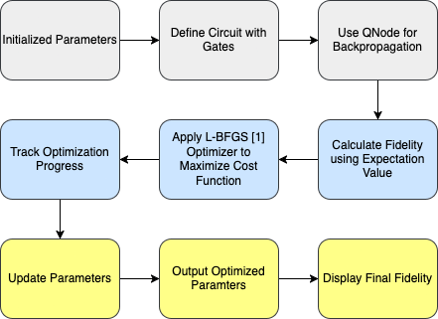
Implementation
Optimization
Our implementation
From paper
D. C. Liu and J. Nocedal, “On the limited memory bfgs method for large scale optimization,” Mathematical pro- gramming, vol. 45, no. 1, pp. 503–528, 1989.
Does not specify how many parameters they are tuning
[1] https://pytorch.org/docs/stable/generated/torch.optim.LBFGS.html
Notes:
Richy rich
MENTION 26 PARAMS ->
Assumptions: 6 encoding and 20 recovery parameters for variational circuit, default parameters and setting of pyTorch L-BFGS.
QNode: A special function that runs your quantum circuit.
Backpropagation: A method that helps us understand how to change the parameters of the quantum circuit so we get better results next time.
How it works together: The QNode runs the quantum circuit, and backpropagation helps us learn how to adjust the parameters (like angles in quantum gates) to improve the output.
1. Initialize Parameters
Start with random parameters or predefined values.
These parameters are used in the quantum circuit.
2. Define Quantum Circuit with Gates
Set up the quantum circuit with gates (like Pauli-X, Y, Z, or controlled operations).
The quantum circuit might also include noise models and encodings.
3. Use QNode for Backpropagation
A QNode is a function that runs a quantum circuit on a device.
The device is configured for backpropagation (gradients computation) with Torch.
4. Calculate Fidelity Using Expectation Value
Compute the fidelity (a measure of similarity) of the output quantum state with a target state using qml.expval.
5. Apply L-BFGS Optimizer to Minimize Cost
The optimizer adjusts the parameters in the quantum circuit to minimize a cost function, in this case, the fidelity.
6. Track Optimization Progress
Monitor the cost function and other variables (like time and parameters) during the optimization process.
7. Update Parameters
The optimizer updates the parameters after each iteration to improve the fidelity.
8. Output Optimized Parameters
After several iterations, the optimizer produces the final values for the parameters (alpha and beta).
9. Display Final Cost
The cost (or fidelity) at the end shows how close the quantum circuit is to the desired output.

Slide 34

IV.
Results

Slide 35
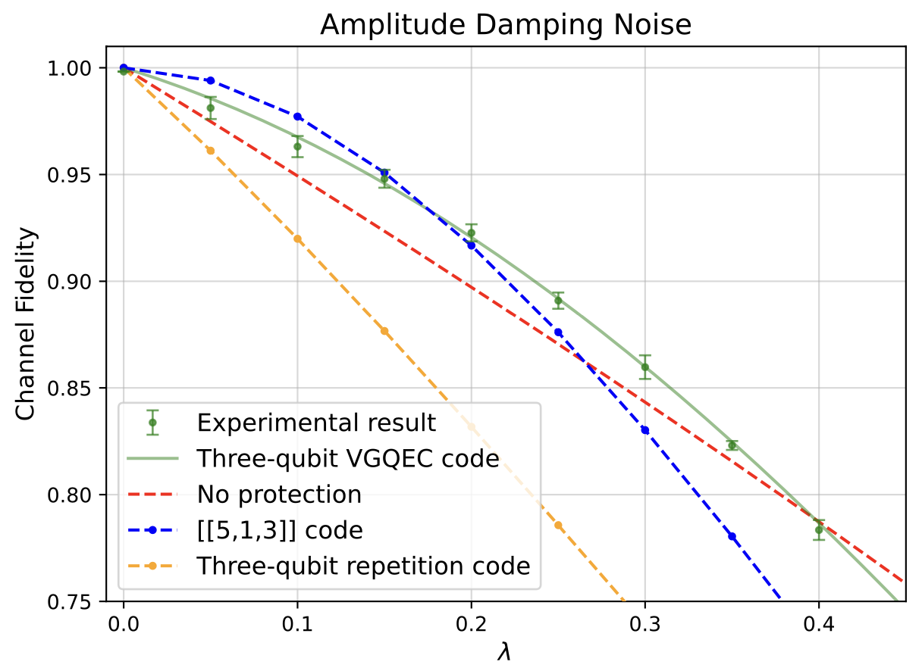
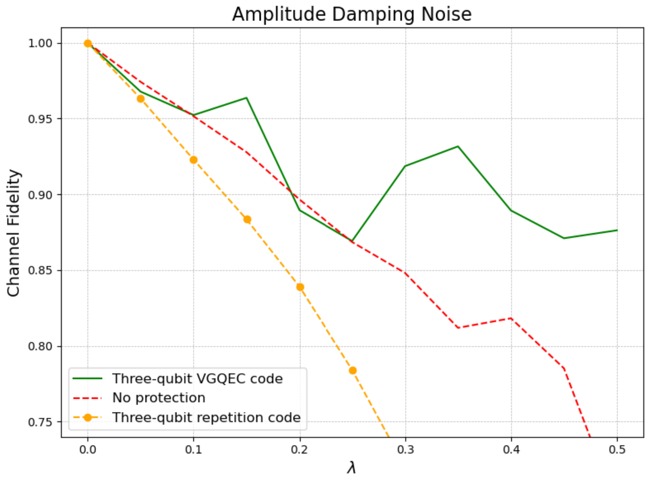
Results
Simulated Graphs
Notes:
Lina

Slide 36

Demo
Results

Slide 37

Thank you!

Slide 38

Questions?

Slide 39
Resoruces:
https://research.google/blog/making-quantum-error-correction-work/?utm_source=chatgpt.com
http://theory.caltech.edu/~preskill/ph229/notes/chap7.pdf
https://www.dhuality.com/posts/2022-09-27-qec513code/#:~:text=In%20this%20code%2C%20five%20physical,psi%5Crangle%20%E2%88%A3%CF%88%E2%9F%A9.

